Slide 1

MACHINE LEARNING COURSE PROJECT FINAL REVIEW
Multi-Objective PPO-Based Receiver Energy & SIC-Aware NOMA Scheduling
Learning to schedule NOMA users with an RL agent that balances speed, battery life, and receiver complexity.
Ranga Charvik Battagiri | ID: 2520040108
A. Dhanush | ID: 2520040109
R. Gnaneshwar | ID: 2520040076
Department of ECE • KL Deemed to be University (KLH)

Slide 2



5G/6G Device Density
Massive volumes of connected IoT devices sharing limited radio spectrum.
Why This Project Matters
NOMA's Efficiency Trade-off
Packs more users per channel, demanding complex receiver signal unmixing.
Networks are crowding rapidly, yet existing scheduling solutions critically ignore device battery limits.
The Missing Scheduler Piece
Heavy signal decoding severely drains neglected batteries on low-power devices.

Slide 3
How NOMA Power Allocation Works
Multiple users share the same time-frequency slot, separated by assigned power levels.
HIGH POWER
MID POWER
LOW POWER
User A — Weak Channel
User B — Medium Channel
User C — Strong Channel
Given high power share so signal survives direct interference.
Allocated intermediate power requiring partial isolation.
Decodes own signal smoothly through adjacent interference.

Slide 4
SIC: The Hidden Cost of NOMA
Every receiver must peel apart the combined signal sequentially.
1
2
3
4
Decode Strongest
Subtract Signal
Decode Next
Repeat Process
Isolate highest power signal.
Remove from composite mix.
Process remaining wave.
Loop until complete isolation.
Core Tension: Bigger clusters improve spectral efficiency, but increase SIC stages — draining battery on devices that can least afford it.

Slide 5
Bridging the Literature Gap
Moving beyond single-objective, battery-blind throughput optimization.
What's Been Studied
What's Missing
Q-learning for power allocation post-clustering.
Optimization algorithms usually ignore SIC dynamics entirely.
Object Migration Automata for user grouping.
Zero adaptation to individual users' remaining battery.
Power models treating SIC as a fixed static cost.
Lack of explicit rewards for battery-aware cluster decisions.

Slide 6
Project Objectives
The systematic approach to solving the NOMA scheduling challenge.
01
Model a simplified NOMA downlink system in Python incorporating throughput and exact receiver energy cost.
02
Formulate the dynamic scheduling process as a discrete-time Markov Decision Process (MDP).
03
Train a PPO agent governed by a custom multi-objective reward function balancing speed and battery life.
04
Implement robust Random, Fixed, and Greedy baseline schedulers for accurate benchmarking.
05
Evaluate models comprehensively across average throughput, total energy, SIC stages, and network fairness.

Slide 7
MDP Formulation
Mapping dynamic NOMA scheduling into a reinforcement learning architecture.
STATE SPACE
ACTION SPACE
Current channel gain + remaining battery level of every active user.
Explicit NOMA cluster ID assignment generated for each specific user.
REWARD SIGNAL
POLICY
Weighted combination prioritizing throughput minus energy costs and SIC stages.
The robust scheduling strategy iteratively learned by the PPO agent.
Reward = (1.0 × Throughput) − (2.5 × Energy Cost) − (1.0 × SIC Stages)

Slide 8
System Model Formulas
The exact mathematical constraints dictating environment physics.
Shannon Capacity
Higher SINR yields better rates.
SIC Stages
Decoding steps required.
Weighted Energy
Urgency multiplier applies 4× cost.

Slide 9



Implementation & Workflow
Built purely in Python leveraging standard modern RL libraries.
Gymnasium
Stable-Baselines3
NumPy
Custom environment handling reset, step logic, and reward.
Robust implementation of the PPO network architecture.
Vectorized calculations for SINR, throughput, and state updates.
Why Multi-Seed Training?
PPO can converge to different local optima depending on random weight initialization. We executed training across 3 independent seeds for 200,000 timesteps each, keeping the model with the best evaluation score. This guarantees a mathematically trustworthy result, rather than a lucky one-off training run.

Slide 10
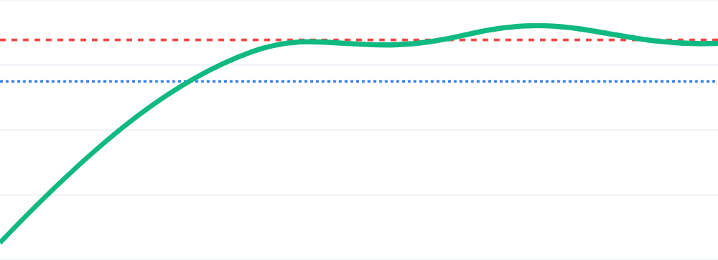
PPO Agent Training Convergence
Monotonic improvement of the episodic reward over 200k timesteps.
0
-1
-2
-3
-4
Training Timesteps (0 → 200,000)
PPO Reward
Eval Score (-0.613)
Greedy Target (-1.251)

Slide 11
Combined Multi-Objective Results
+51% vs. Greedy
Evaluation scores averaged over 30 independent episodes.
PPO (Ours)
-0.613
Greedy
-1.251
Fixed
-1.582
Random
-4.979

Slide 12
Detailed Metric Comparison
Dissecting the specific operational behaviors of each scheduler policy.
Average Throughput (Higher = Better)
Energy Cost (Lower = Better)
SIC Stages (Lower = Better)
Jain's Fairness (Higher = Better)
PPO
Greedy
Greedy
Fixed
Greedy
Fixed
Fixed
Greedy
Fixed
PPO
PPO
PPO
Random
Random
Random
Random

Slide 13

Why the PPO Scheduler Excels
An honest trade-off built on dynamic observation.
Battery Visibility Advantage
Baselines blindly cluster dying devices. PPO explicitly observes remaining energy and isolates vulnerable nodes.
The Fairness/Energy Baseline Artifact
Greedy and Fixed models score well on fairness simply because they construct perfectly even static clusters.
The Optimal Multi-Objective
No single method should arbitrarily dominate every axis. By balancing mathematically proven throughput gains against survival, PPO achieves the superior operational trade-off.
Strategic Asymmetry
PPO trades away perfectly uniform clustering logic to secure massive sum throughput gains.

Slide 14
Advancing Sustainable 6G Connectivity
Jointly optimizing throughput, energy, and SIC complexity via Reinforcement Learning ensures network longevity beyond static heuristics.
FUTURE DIRECTIONS
PROJECT AUTHORS
→ Model imperfect SIC / error propagation.
Ranga Charvik Battagiri
→ Implement true Pareto-front algorithms.
A. Dhanush
→ Scale to massive multi-cell clustering.
R. Gnaneshwar

Slide 15

Image Sources
https://img.magnific.com/premium-photo/blue-wifi-signal-symbol-against-clean-backdrop-3d-rendered-abstract-representation_1281529-49473.jpg?semt=ais_hybrid&w=740&q=80
Source: www.magnific.com

